Slide 1
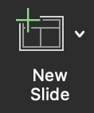
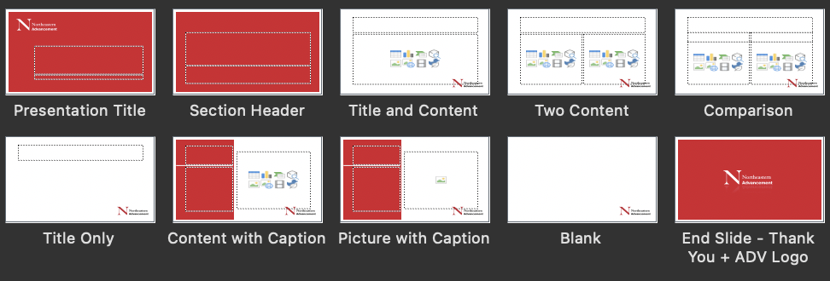
*This is an instruction slide.
You can keep me around for reference until you’re ready. Then, just delete me!
This template uses “Master” slides, which means many slide types have already been created for you, and well some other fun things like slide transitions are built in. This ensures a consistent and high-quality presentation.
HOW TO USE MASTER SLIDES:
Check out the slide options by navigating to the “New Slide” (downward caret) dropdown
Select the slide type best suited to your needs. They are named appropriately.
Something not looking right? If needed, navigate to “View > Master > Slide Master” to see where the magic happens and adjust.
Try adding a new slide now!

